Slide 1
SOFTWARE PROCESS MODELS

Slide 2
NEED FOR MODELING A PROCESS
When a team writes down a description of its development process it forms a common understanding of the activities, resources and constraints involved in software development.
Creating a process model helps the team find inconsistencies, redundancies and removals in the process, as these problems are noted and corrected the process becomes more effective.

Slide 3
The model reflects the goals of development and shows explicitly how the product characteristics are to be achieved.
Each development is different and a process has to be tailored for different situations, the model helps people to understand these differences.

Slide 4
Waterfall Model
This is the most basic software development life cycle process which is followed broadly in the industry. Here the developers follow a sequence of processes where the processes flow progressively downwards towards the ultimate goal. It is like a waterfall where there are a number of phases.

Slide 5
Advantages
Easy to implement and maintain.
The initial phase of rigorous scrutiny of requirements and systems helps in saving time later in the developmental phase
The requirement of resources is minimal and testing is done after completion of each phase.

Slide 6
WHEN TO USE
Requirements of the complete system are clearly defined and understood.
Major requirements must be defined.
There is a need to get a product to the market early.
A new technology is being used.
Resources with needed skill set are not available
For small Projects.

Slide 7
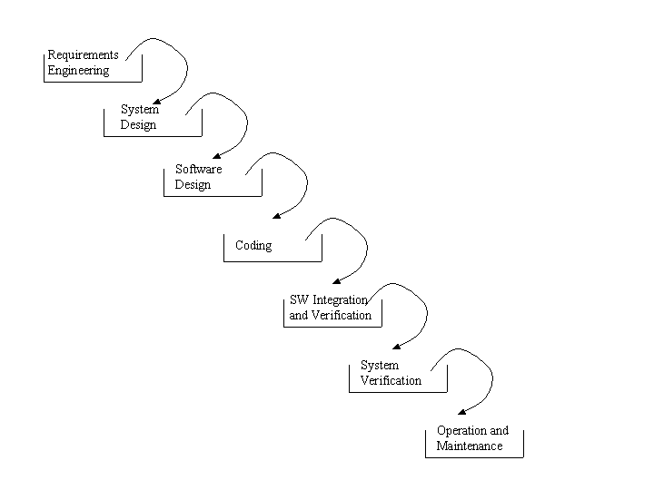

Slide 8
Disadvantages
It is not possible to alter or update requirements
You cannot make changes once you are into the next phase.
Cannot start the next phase until the previous phase is completed

Slide 9
INCREMENTAL PROCESS MODEL
Development occurs as a succession of releases with increasing functionality.
Combines elements of the water fall model applied in an iterative fashion.
Each linear sequence produces deliverables of the software.
Customers provide feedback on each release, used in deciding requirements and improvements for next release.
There is no “maintenance” phase – each version includes both problem fixes as well as new features.

Slide 10
ADVANTAGES
Customers get usable functionality earlier than with waterfall.
Early feedback improves likelihood of producing a product that satisfies customers.
The quality of the final product is better
The core functionality is developed early and tested multiple times (during each release)
Only a relatively small amount of functionality added in each release: easier to get it right and test it thoroughly
Detect design problems early and get a chance to redesign

Slide 11
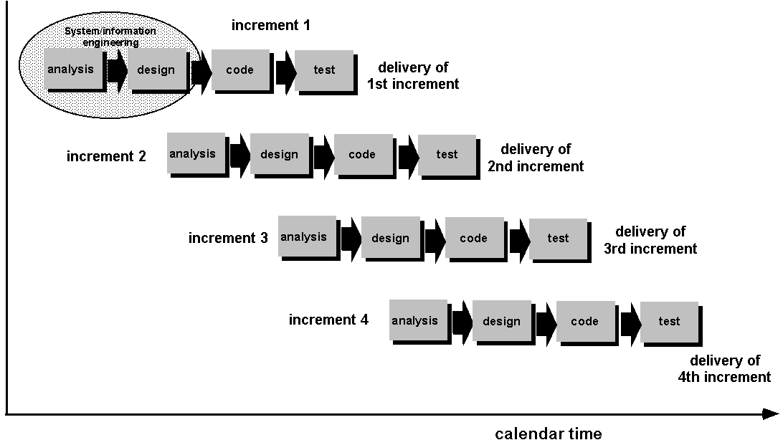

Slide 12
DISADVANTAGES
Needs good planning and design.
Needs a clear and complete definition of the whole system before it can be broken down and built incrementally.
Total cost is higher than waterfall.

Slide 13
RAD DEVELOPMENT MODEL
RAD is an incremental software process model that emphasizes a short development cycle.
Using Component based construction approach.

Slide 14
Rapid application development
This is another incremental model like the Agile model. Here the components are developed parallelly to each other. The developments are then assembled into a product.

Slide 15
Advantages
The development time is reduced due to simultaneous development of components and the components can be reused
A lot of integration issues are resolved due to integration from the initial stage

Slide 16
Disadvantages
It requires a strong team of highly capable developers with individual efficacy in identifying business requirements
It is a module based model, so systems that can be modularized can only be developed in this model
As the cost is high, the model is not suitable for cheaper projects

Slide 17
PROTOTYPING MODEL
Customer defines a set of general objectives for software but doesn’t identify the detail.
Assist the software engineer and the customer to better understand what is to be built when requirement are fuzzy.

Slide 18
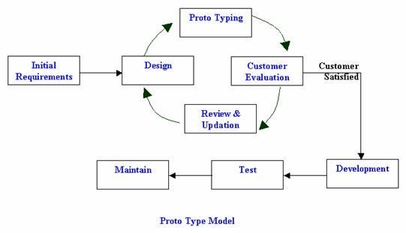

Slide 19
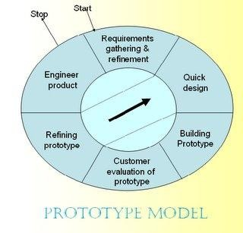

Slide 20
SPRIAL PROCESS MODEL
A hybrid model where the development of the system spirals outward from an initial outline through to the final developed system.
Each loop in the spiral represents a phase of the software process.
Like the innermost loop might be concerned with system feasibility, next loop with system requirements, next loop with system design and so on.
Each loop in the spiral is split into four sectors:
Object Setting: set specific object for that phase.
Risk assessment and reduction.
Development and validation: select a development model based on risk levels.
Planning: decide if a next loop is required

Slide 21
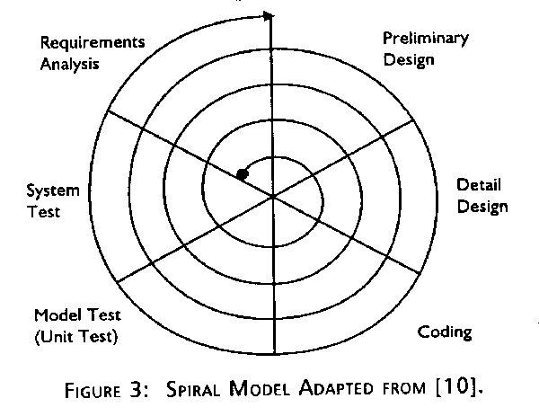

Slide 22
ADVANTAGES & DISADVANTAGES
Advantages
Explicit consideration of risks (alternative solutions are evaluated in each cycle).
More detailed processes for each development phase.
Disadvantages
Cost is high.
Sometime difficult to implement or too time consuming.

Slide 23
V Model
This model is widely recognized as superior to waterfall model. Here the development and test execution activities are carried on side by side in the downhill and uphill shape. In this model, testing starts at the unit level and spreads towards integration of the entire system.

Slide 24
Advantages
Easy to use the model since testing activities like planning and test designing are done before coding
Saves time and enhances chances of success.
Defects are mostly found at an early stage and downward flow of defects is generally avoided

Slide 25
Disadvantages
It is a rigid model
Early prototypes of the product are not available since the software is developed during the implementation phase
If there are changes in the midway, then the test document needs to be updated

Slide 26
Agile model
In this SDLC model requirements and solutions evolve through collaboration between various cross functional teams. This is known as an iterative and incremental model.

Slide 27
Advantages
Ensure customer satisfaction with rapid and continuous development of deliverables.
It is a flexible model as customers, developers and testers continuously interact with each other
Working software can be developed quickly and product can be adapted to changing requirements regularly

Slide 28
Disadvantages
In large and complex software development cases it becomes difficult to assess the effort required at the beginning of the cycle
Due to continuous interaction with the customer, the project can go off track if the customer is not clear about the goals

Slide 29
Review Questions
Give one software example for each type of model.

Slide 30
Thank you

